Slide 1
Java 4 WEB
Lesson 15 - Home Task Overview

Slide 2
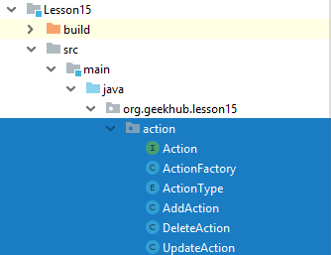
1. Reuse, don’t copy-paste

Slide 3
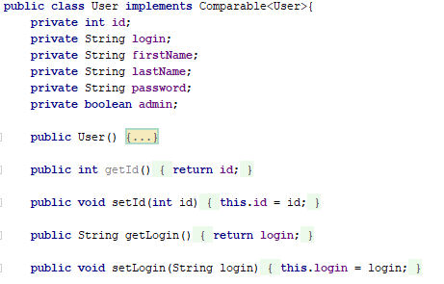
2. Where is immutability?

Slide 4
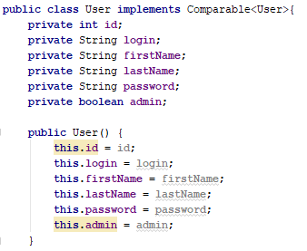
3. What?
Notes:
What is the logic in constructor implementation?

Slide 5
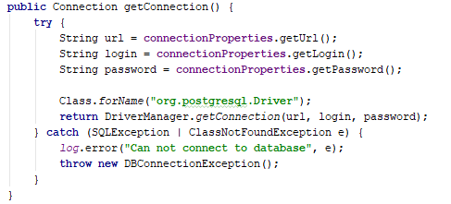
4. Load driver only once

Slide 6
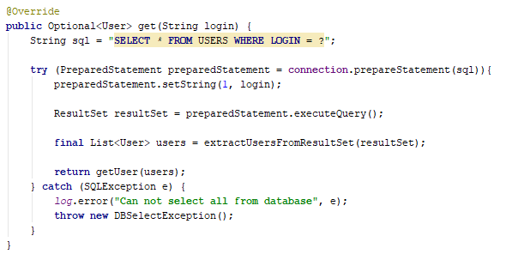
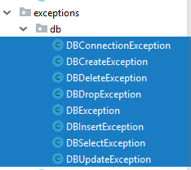
5. Supply more info about error
Notes:
Always add cause to the exception

Slide 7
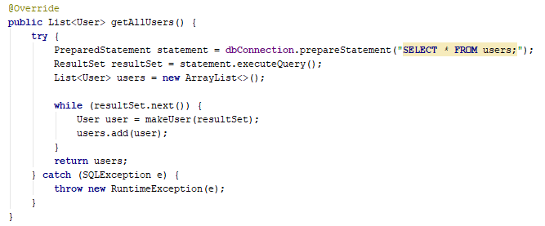
5. Supply more info about error

Slide 8
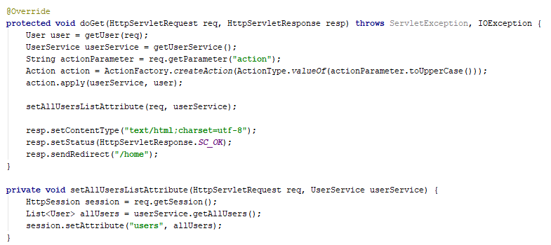
6. Do not use session as storage
Notes:
Always add cause to the exception

Slide 9
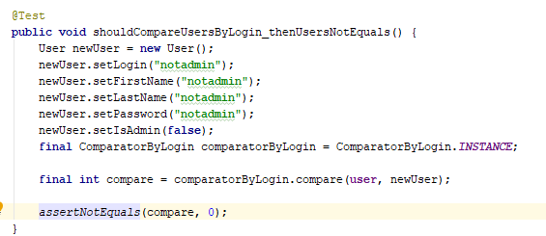
7. Only one result is valid

Slide 10
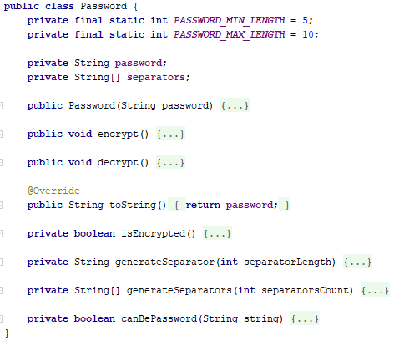
8. Keep it simple

Slide 11
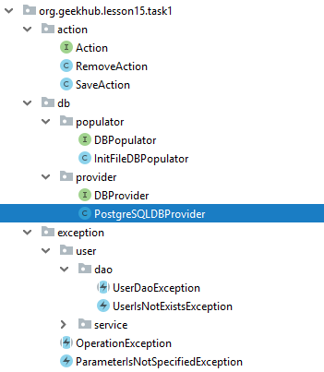
9. Group code by domain

Slide 12
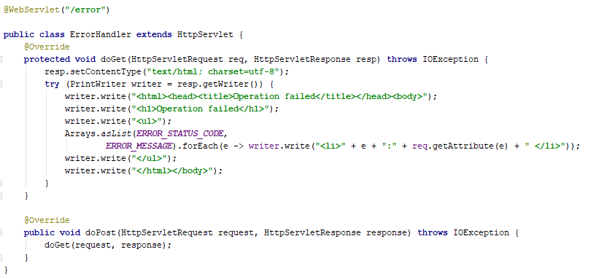
10. Use Java Server Page

Slide 13
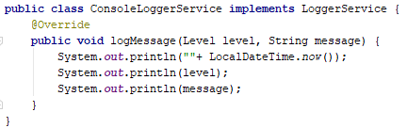
11. Do a single out invocation
Notes:
One thread logger can interrupt process of another thread logger and logs will be mixed and useless

Slide 14
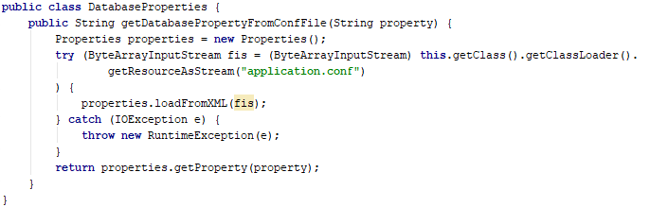
12. Read properties once

Slide 15
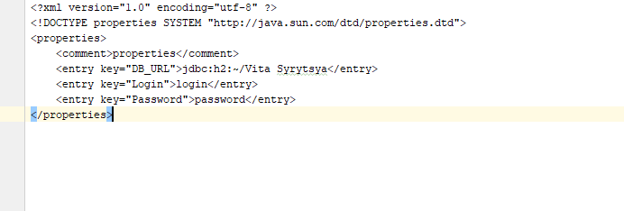
13. application.conf is not xml

Slide 16
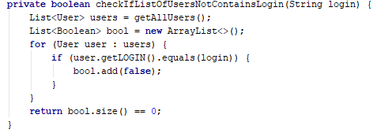
14. Do not read all data for save of one

